Slide 1


SMART INDIA HACKATHON 2024
TEAM
SarvaLink
Aadhar And Digilocker Based Unified Device For College
Problem Statement ID : SIH1625
Problem Statement Title : Smart Automation
Theme : Smart Automation
PS Category : Software
Team ID : 495
Team Name (Registered on portal) : SarvaLink

Slide 2
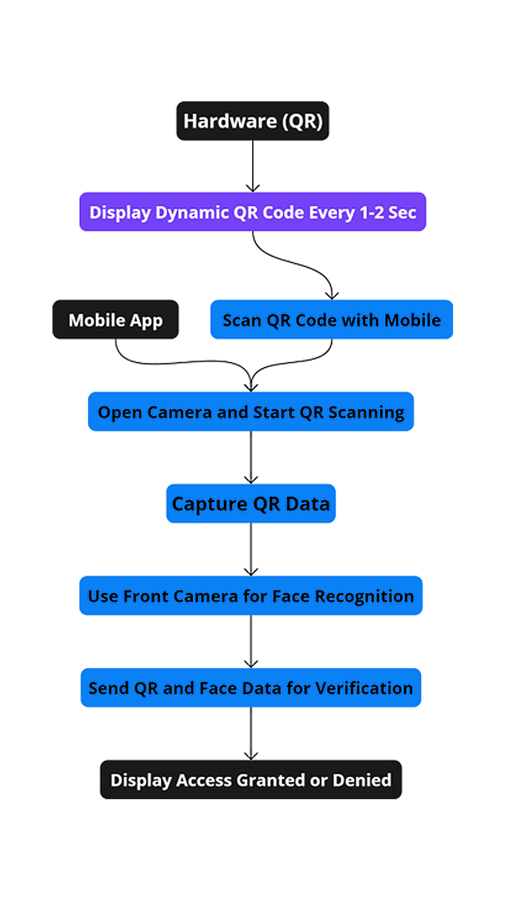
SARVALINK
TEAM
SarvaLink
Problem Statement:
Educational institutions struggle with inefficient manual systems for attendance, data access, and secure authentication. The lack of a unified platform integrating Aadhar and ABC complicates identity verification and academic record management. Proposed Solution: A unified college management system integrating QR code scanning, biometric face recognition, Aadhar, and the Academic Bank of Credits (ABC). With dual authentication, it automates attendance, manages departments, and enhances security and efficiency in academic institutions.
How It Addresses The Problem:
Streamlines department workflows (library, accounts, exams, hostel) with real-time data syncing.
Enhances security via dual authentication using Aadhar and biometric verification.
Integrates ABC for seamless academic credit management.
Reduces fraud in identity verification during exams.
Automates attendance tracking through QR scanning and face recognition, eliminating manual errors.
For Referance Watch this: https://youtu.be/JNJ41hFCE5Q
Fig.1) How Will QR System Work

Slide 3
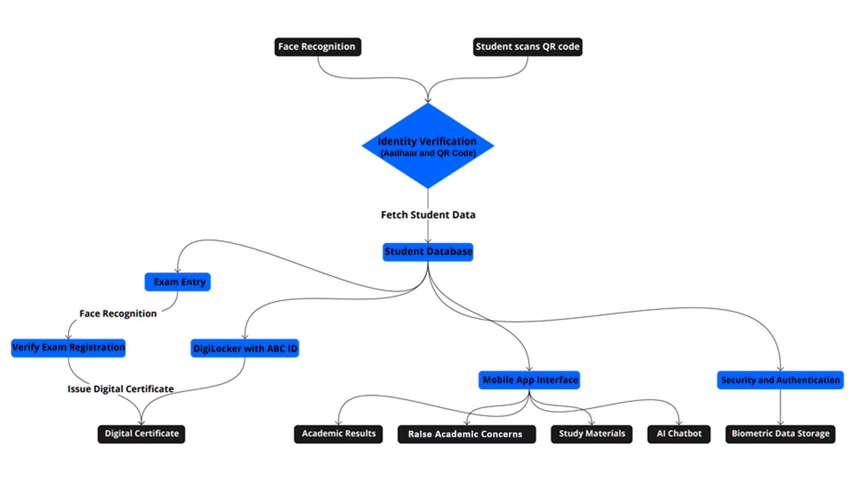
TECHNICAL APPROACH
TEAM
SarvaLink
Dynamic QR code and Face Recognition
Hardware Used & Costing:
ESP32
LCD Screen
Battery & it’s Module
Total costing :- ₹899
Frontend:
APP(for students)
WEB APP (for admin)
Backend:
Directus
Python
Database
Fig.2) How Will Overall System Work
3

Slide 4
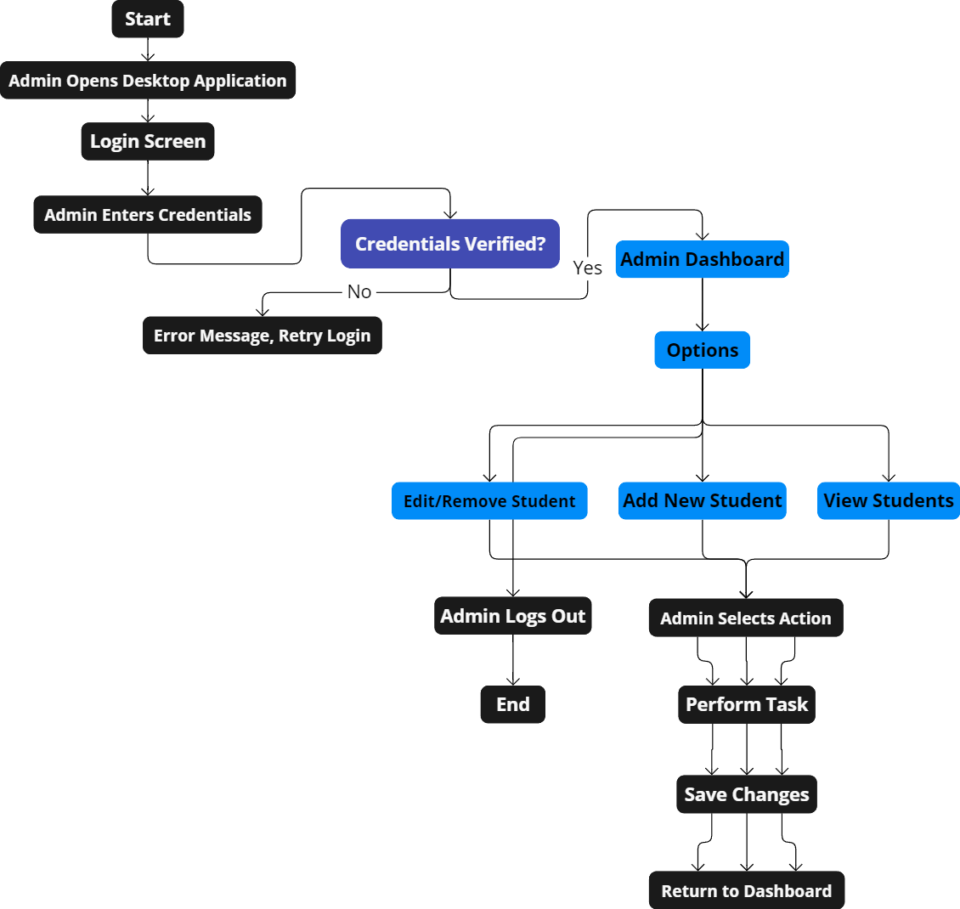
FEASIBILITY AND VIABILITY
Feasibility:
Technical: QR code, face recognition, Aadhar, ABC integration are feasible with existing technology and cloud infrastructure.
Operational: Intuitive system with minimal training required; easily adopted across departments.
Legal/Security: Follows data protection and Aadhar compliance regulations.
Viability:
Cost: Initial investment offset by long-term savings in administrative costs and efficiency gains.
Sustainability: Reduces paperwork, scalable across departments, and future-proof with ABC integration.
Satisfaction: Streamlined processes improve student/staff experience, supporting institutional modernization.
Fig.3) How Will Admin Dashboard Work

Slide 5
FUTURE SCOPE & IMPACT , BENEFITS
TEAM
SarvaLink
Future Scope:
AI-Based Analytics: Track student performance, attendance, and library usage for personalized learning insights.
Blockchain Integration: Securely store academic credentials, enabling verifiable and transferable transcripts and certificates.
National Integration: Integrate with platforms like DigiLocker and National Academic Depository (NAD) for easy document management.
IOT Integration: Use smart devices for automated student check-ins for attendance and hostel entry.
Campus Automation: Manage facilities with automated monitoring for smart classrooms and energy systems.
Impact & Benefits:
Efficiency Boost: Automates attendance, fee management, and library processes, reducing manual work and errors.
Improved Security: Biometric face recognition and Aadhar integration ensure secure student verification and data protection.
Time Savings: Streamlines operations across departments, speeding up tasks like exam registration, fee payments, and book borrowing.
Student Empowerment: Real-time access to academic results, study materials, and a query system enhances the student experience.
Data Centralization: Unified system links academic records with ABC for seamless credit and performance tracking.
Environmental Sustainability: Paperless processes reduce waste and support green initiatives.

Slide 6
RESEARCH AND REFERENCES
TEAM
SarvaLink
Research Paper
QR Codes in Education – A Study on Innovative Approach in Classroom Teaching https://www.researchgate.net/publication/359197516_
A Novel QR Code Based Smart Attendance Tracking System https://www.researchgate.net/publication/378110423_
Blending Classroom Teaching and Learning with QR Codes https://www.researchgate.net/publication/263075152_
Articles
How Teachers Are Using QR Codes in the Classroom to Enhance Learning https://www.qr-code-generator.com/blog/qr-codes-in-the-classroom/
Exploring the potential of QR codes in higher education
https://www.researchgate.net/publication/281587370
How can integrated school management systems benefit modern education? https://www.classter.com/blog/edtech/integrating-school-management-systems-in-modern-education/

